Slide 1
Front End Web Development
Topic 9: Responsive CSS Framework:
Bootstrap - I
Notes:
NCC Education - Title Master

Slide 2
Scope and Coverage
This topic will cover:
Bootstrap introduction
Bootstrap containers
Grid system in bootstrap framework
Bootstrap content elements
Notes:
NCC Education - Slide Master

Slide 3
Learning Outcomes
By the end of this topic students will be able to:
Use Bootstrap concepts and develop responsive web pages
Demonstrate understanding of basic bootstrap concepts including Bootstrap installation
Identify different types of Bootstrap containers and explain its concepts
Explain the grid system under bootstrap framework and some of its content elements

Slide 4
Unit Roadmap
Week | Topic | Week | Topic
1 | Overview of Web Application Architecture | 7 | JavaScript - II
2 | Introduction to HTML5 | 8 | jQuery
3 | Introduction to CSS | 9 | Responsive CSS Framework: Bootstrap - I
4 | HTML and CSS | 10 | Responsive CSS Framework: Bootstrap - II
5 | CSS Flexbox and Grid Layout | 11 | Code Review and Testing. and Collaboration
6 | JavaScript - I | 12 | Unit Summary

Slide 5
BOOTSTRAP

Slide 6
What is Bootstrap?
Bootstrap is a free, open-source software
Most popular HTML, CSS, and JavaScript framework
Developed by twitter
Used for creating responsive web applications
Widely used to create a web application built with any server-side technologies like ASP.NET, JAVA, PHP etc.

Slide 7
Why use Bootstrap?
Mobile first approach:
The framework consists of Mobile-first styles
Browser Support:
It is supported by all popular browsers
Easy learning curve:
Requires knowledge of HTML and CSS
Responsive design:
Responsive CSS adjusts to desktops, tablets and mobiles

Slide 8
Bootstrap Features
Scaffolding:
Bootstrap provides a basic structure with Grid System, link styles, background.
CSS:
Provides global CSS settings
HTML elements enhanced with extensible classes
An advanced grid system.
Components:
Bootstrap contains reusable components that provides:
Iconography
Dropdowns
Navigation
Alerts
Popovers, and much more.

Slide 9
Bootstrap Features
JavaScript Plugins:
Bootstrap contains a variety of customized jQuery plugins
Flexibility:
Customise Bootstrap's components and jQuery plugins to create own customized version
Download Bootstrap
Download at: http://getbootstrap.com/.

Slide 10
Quiz - 1
1. Which of the following is a key feature of Bootstrap?
A) Requires deep knowledge of JavaScript to use
B) Mobile-first design approach
C) Only offers grid system
2. Bootstrap's grid system is based on how many columns?
A) 6
B) 12
C) 24
3. Which component is NOT a part of Bootstrap's components?
A) Carousel
B) Accordion
C) Tooltip
D) Vector Graphics
Notes:
Correct Answer: B) Mobile-first design approach
Correct Answer: B) 12 Correct Answer: D) Vector Graphics

Slide 11
Bootstrap containers

Slide 12
Containers
.container class used for a responsive fixed-width.
Syntax:
<div class="container">
…..
</div>
.container-fluid for a full-width container.
Syntax:
<div class="container-fluid">
...
</div>

Slide 13
Containers
Purpose:
To wrap and centre site content.
Responsiveness:
Adapts to various screen sizes with different container classes (container, container-fluid, container-sm/md/lg/xl/xxl).
Fixed-width:
Except for container-fluid, all containers have a maximum width for each breakpoint.
Margins:
Automatically adds horizontal padding for content inside.

Slide 14
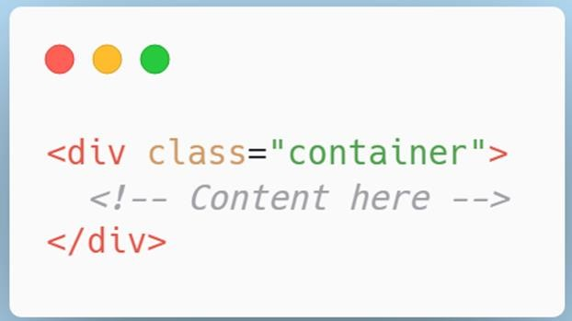
Default Container
Responsive
Fixed-width Container
Max-width changes at each breakpoint

Slide 15
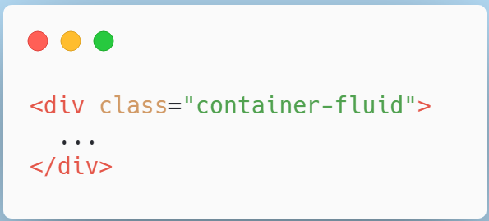
Fluid Container
Full width container
Spans the entire width of the viewport

Slide 16
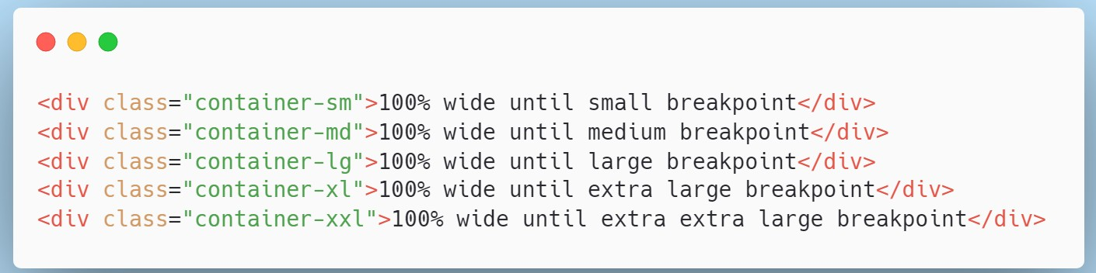
Responsive Container
100% width until the specified breakpoint is reached

Slide 17
Container Breakpoints
Class Prefix | Min-Width | Description
.container | None | Auto adjusts based on the viewport.
.container-sm | 576px | For smartphones (landscape).
.container-md | 768px | For tablets.
.container-lg | 992px | For laptops and desktops.
.container-xl | 1200px | For large desktops.
.container-xxl | 1400px | For extra large screens.

Slide 18
Quiz - 2
1. Which class is used to create a fixed-width container in Bootstrap?
A) .container-fixed
B) .container
C) .container-fluid
2. To create a full-width container that spans the entire width of the viewport, which class should be used?
A) .container-full
B) .container-fluid
C) .container-wide
3. Which statement is true about Bootstrap containers?
A) Containers can be nested inside each other.
B) You cannot use more than one container in a webpage.
C) .container and .container-fluid provide the same fixed width to the container.
Notes:
Correct Answer: B) .container
Correct Answer: B) .container-fluid
Correct Answer: A) Containers can be nested inside each other.

Slide 19
Bootstrap grid system

Slide 20
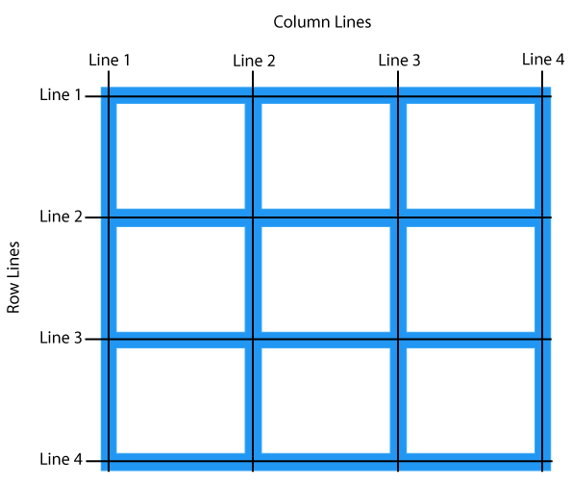
Recap - What is a Grid?
Grid is a structure made up of a series of intersecting straight (vertical, horizontal) lines to structure the content.
In web design, it is a very effective method to create a consistent layout rapidly and effectively using HTML and CSS.
Allows to organise and structure content, makes the websites easy to scan and reduces the load on users.

Slide 21
Recap - Grid System Description
Grid System consists of 12 columns.
Creates page layouts through a series of rows and columns.
Rows must be placed with a .container (fixed –width) or
.container –fluid (full-width) for proper alignment and padding.
Use rows to create horizontal group of columns.
Content should be placed within columns, and only columns may be immediate children of rows.

Slide 22
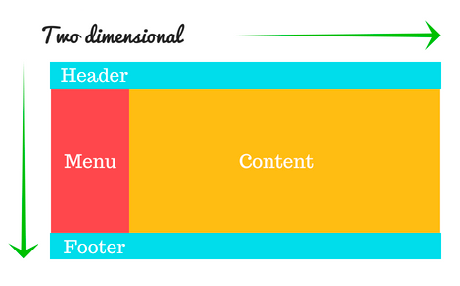
Bootstrap Grid System
Bootstrap grid system works with following considerations:
Rows & Columns:
Built on a flexible 12-column grid layout.
Responsiveness:
Use breakpoints to determine column width & stacking.
Classes:
Prefix like .col-md-4 means "Use 4 columns out of 12 on medium devices".
Nesting:
Place rows within columns for more granular layouts.
Gutters:
Spacing between columns, adjustable with .g* utilities.

Slide 23
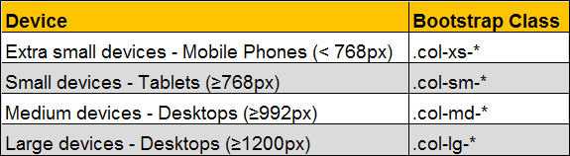
Grid Classes
The Bootstrap grid system has four classes:
xs (for phones)
sm (for tablets)
md (for desktops)
lg (for larger desktops)

Slide 24
Bootstrap Grid System: Device Comparison
Feature/Device | Extra Small <576px | Small ≥576px | Medium ≥768px | Large ≥992px | Extra Large ≥1200px | XXL ≥1400px
Max Container Width | Auto | 540px | 720px | 960px | 1140px | 1320px
Gutters | 16px (default) | 16px (default) | 24px (default) | 24px (default) | 24px (default) | 24px (default)
Class Prefix | .col- | .col-sm- | .col-md- | .col-lg- | .col-xl- | .col-xxl-
Columns | 12 | 12 | 12 | 12 | 12 | 12
Max Column Width | Auto | 45px | 60px | 80px | 95px | 110px
Nestable | Yes | Yes | Yes | Yes | Yes | Yes
Offsets | Available | Available | Available | Available | Available | Available
Grid Behaviour | Horizontal to stacked | Horizontal | Horizontal | Horizontal | Horizontal | Horizontal

Slide 25
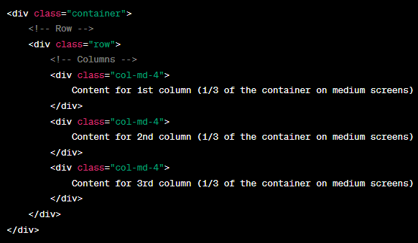
Bootstrap Grid Example
The .container class is used to wrap the site content.
The .row class denotes a new row.
The .col-md-4 classes divide the row into three equal columns on medium-sized devices (like tablets).

Slide 26
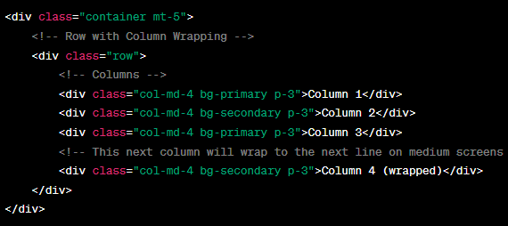
Bootstrap Grid Characteristics
Column-wrapping:
More than 12 columns are placed within a single row, Each group of extra columns will wrap onto a new line.
Example below:
The .row contains four .col-md-4 columns, totaling 16 columns.
On medium screens and larger (md), columns will total up to 12 in one row. The extra column(s) will wrap onto the next line, which means "Column 4 (wrapped)" will appear on the next line by itself.

Slide 27
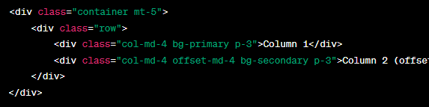
Bootstrap Grid Characteristics
Offsetting columns in Bootstrap allows you to create space (empty columns) before a column
Example below:
Column 1 occupies 4 grid spaces on medium (md) screens.
Column 2 is offset by 4 grid spaces, creating a visible gap between the two columns, and then occupies the next 4 grid spaces on medium (md) screens.

Slide 28
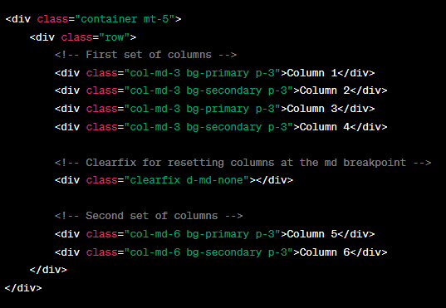
Bootstrap Grid Characteristics
.clearfix utility in Bootstrap is used to clear floats.
It is useful when columns aren't of equal height, and you want to ensure that columns in the next "row" start on a new line.
Example below:
We have two sets of columns.
The first set contains four columns each of col-md-3 which together take up the full width of 12 columns.
We then use .clearfix with the class d-md-none. This ensures that the clear fix is applied only up to medium screens (md), making it invisible on md and larger screens.
Ensures that the next set of columns will start on a new line despite unequal column heights.
The second set contains two columns each of col-md-6.

Slide 29
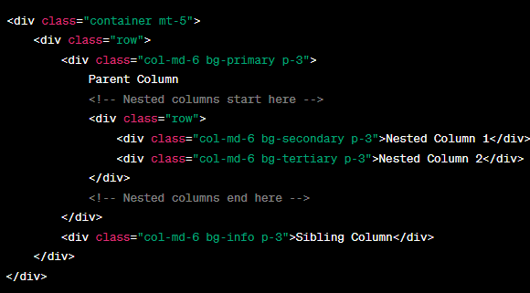
Bootstrap Grid Characteristics
Nesting columns in the Bootstrap grid system means placing a set of columns inside another column.
Example below:
A main row that contains two col-md-6 columns.
Inside the first col-md-6 (Parent Column), there's another row, which represents our nested grid. Within this nested row, we have two col-md-6 columns.
These nested columns will each take up half the width of their parent column when the viewport is at least md in size.
The second col-md-6 (Sibling Column) sits alongside the parent column and is not part of the nesting.

Slide 30
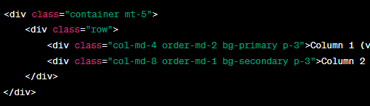
Bootstrap Grid Characteristics
.order-* classes in Bootstrap 4 and later are used to control the visual ordering of columns within a row.
By manipulating the .order-* classes, you can control the visual ordering of columns regardless of their sequence in the HTML source.
Example below:
Even though Column 1 is defined first in the HTML, the order-md-2 class ensures it visually appears second on medium (md) screens and larger.
Column 2, due to the order-md-1 class, will visually appear before Column 1 on medium (md) screens and larger.

Slide 31
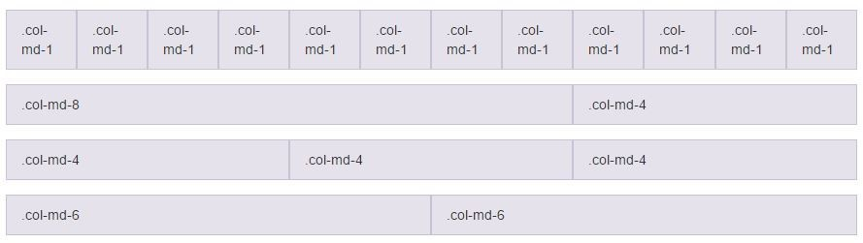
Quiz - 3
Describe the .col-md for each of the row

Slide 32
Bootstrap contents

Slide 33
Typography
Default font stock - Helvetica Neue, Helvetica, Arial, and sans-serif
Typography feature of Bootstrap allows to create headings, paragraphs, lists and other inline elements.
Default font-size is 14px. with a line –height of 1.428.(Applied to <body> and all paragraphs).
Headings:
All HTML headings (h1 to h6) are styled in Bootstrap
<h1>I'm Heading1 h1</h1> Semibold 36px
<h2>I'm Heading2 h2</h2> Semibold 30px
<h3>I'm Heading3 h3</h3> Semibold 24px
<h4>I'm Heading4 h4</h4> Semibold 18px
<h5>I'm Heading5 h5</h5> Semibold 14px
<h6>I'm Heading6 h6</h6> Semibold 12px

Slide 34
Typography
INLINE SUBHEADINGS:
inline subheading can be added to any of the headings
Use <small> around any of the elements or add .small class
Generates smaller text in a lighter color as shown in the example below:
<h1>I'm Heading1 h1. <small>I'm secondary Heading1 h1</small></h1>
<h2>I'm Heading2 h2. <small>I'm secondary Heading2 h2</small></h2>
<h3>I'm Heading3 h3. <small>I'm secondary Heading3 h3</small></h3>

Slide 35
Inline Text Elements
Marked Text: Highlight the text using <mark> tag.
Deleted Text: Blocks of text have been deleted using <del> tag.
Strikethrough Text: Blocks of text that are no longer relevant using the <s> tag.
Inserted text: The <ins> tag defines a text that has been inserted into a document.
Underline Text: The <u>tag defines a underline text.
Small Text: Use the <small> tag to set the text at 85% the size of the parent.
Bold: Text with a heavier font-weight can be done by <strong> tag.
Italics: For Emphasizing of text with italics done by <em> tag.

Slide 36
Alignment Classes
Realign text can be done with text alignment classes.
text-left class used for Left aligned text.
text-right class used for Right aligned text.
text-center class used for Center aligned text.
text-justify class used for Justified text.
text-nowrap class used for No wrap text.

Slide 37
Transformation classes
Transform text by using text capitalization classes.
text-lowercase class used for Lowercased text.
text-uppercase class used for Uppercased text.
text-capitalize class used for Capitalised text.

Slide 38
Abbreviations
Basic Abbreviation:
An abbreviation of the word attribute is attr.
Syntax:
<abbr title="attribute">attr</abbr>
Initialism:
Add .Initialism to an abbreviation for a slightly smaller font-size.
Syntax:
<abbr title="HyperText Markup Language“ class="initialism">HTML</abbr>

Slide 39
Lists
Unordered: A list of items in which the order does not explicitly matter.
<ul>
<li>...</li>
</ul>
Ordered: A list of items in which the order does explicitly matter.
<ol>
<li>...</li>
</ol>
Unstyled: Removes the Default list-style and left margin for list items. It only applies to immediate children of list items.
<ul class="list-unstyled">
<li>...</li>
</ul>

Slide 40
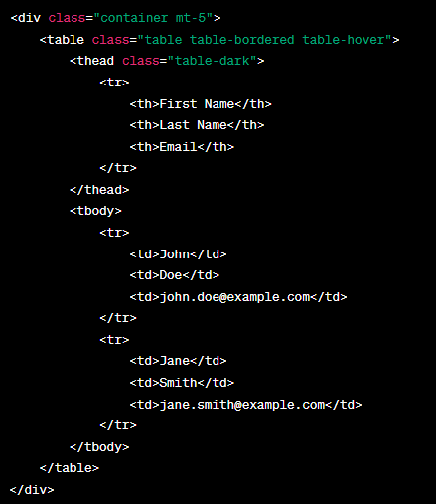
Tables
Example:
We've wrapped our table in a container for proper centering and padding.
The .table class is applied to style the table with Bootstrap's default table styles.
The .table-bordered class adds borders on all sides of the table and cells.
The .table-hover class adds a hover effect on table rows.
The .table-dark class is applied to the table header to give it a dark background for better contrast.

Slide 41

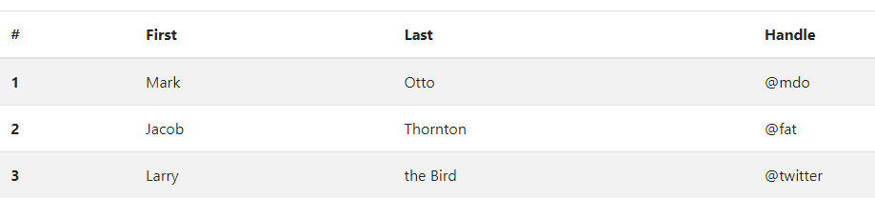
Tables
STRIPED TABLE :
The .table-striped class allows zebra-striping to any rows within the <tbody>.

Slide 42
Tables
Condensed table
the .table-condesend class makes the table more compact by cutting the cell padding in half.
Syntax:
<table class="table table-condensed">
…………….
</table>

Slide 43
Tables - Contextual Classes
Use contextual classes to color table rows or individual cells.
Class | Description
.active | Applies the hover color to a particular row or cell
.success | Indicates a successful or positive action
.info | Indicates a neutral informative change or action
.warning | Indicates a warning that might need attention
.danger | Indicates a dangerous or potentially negative action

Slide 44
Tables – Responsive Tables
RESPONSIVE TABLES:
By wrapping any .table in .table-responsive class, it makes the tables more responsive to screen sizes
The table scrolls horizontally up to small devices (under 768px). When viewing on anything larger than 768px wide, no difference will be seen.
Syntax:
<div class="table-responsive">
<table class="table">
………….
</table>
</div>

Slide 45
Quiz - 4
1. How do you make a table responsive in Bootstrap?
A) Wrap the table with <div class="table-responsive">
B) Add .table-responsive class directly to the <table>
C) It is automatically responsive; no additional class is needed.
2. Which class adds zebra-stripes to a table in Bootstrap?
A) .table-striped
B) .table-zebra
C) .striped-table
3. To add a hover effect over table rows in Bootstrap, which class is used?
A) .table-hover
B) .hover-rows
C) .row-hover
Notes:
Correct Answer: A) Wrap the table with <div class="table-responsive">
Correct Answer: A) .table-striped
Correct Answer: A) .table-hover

Slide 46
References
Books
Syed, M. A. (2020). Bootstrap 5 By Example. Packt Publishing.
Spurgeon, B. (2017). Learning Bootstrap 4, Second Edition. Packt Publishing.
Web Resources
Bootstrap Documentation. Introduction. Available at: https://getbootstrap.com/docs/5.0/getting-started/introduction/
W3Schools. Bootstrap 4 Tutorial. Available at: https://www.w3schools.com/bootstrap4/
MDBootstrap. Bootstrap 5 Tutorial. Available at: https://mdbootstrap.com/education/bootstrap/

Slide 47
Topic 9 – Responsive CSS Framework Bootstrap -I
Any Questions?
Notes:
NCC Education - End Slide Master

